Slide 2
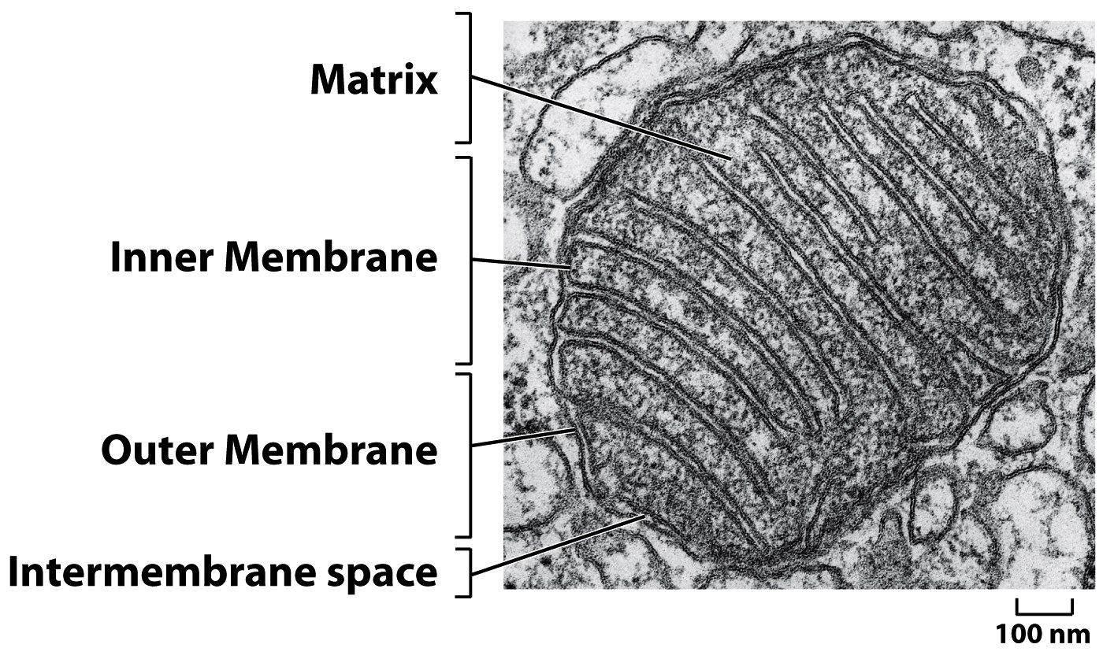
Figure 14-8 (part 1 of 2) Molecular Biology of the Cell (© Garland Science 2008)

Slide 3
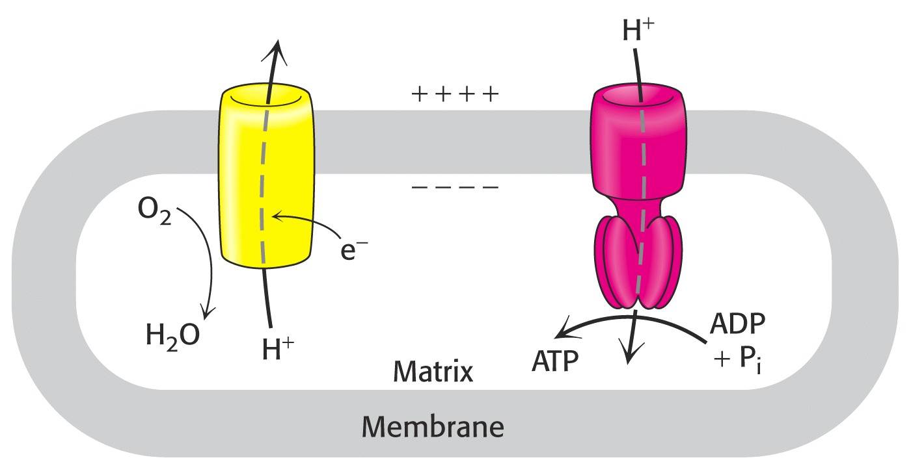

Slide 4
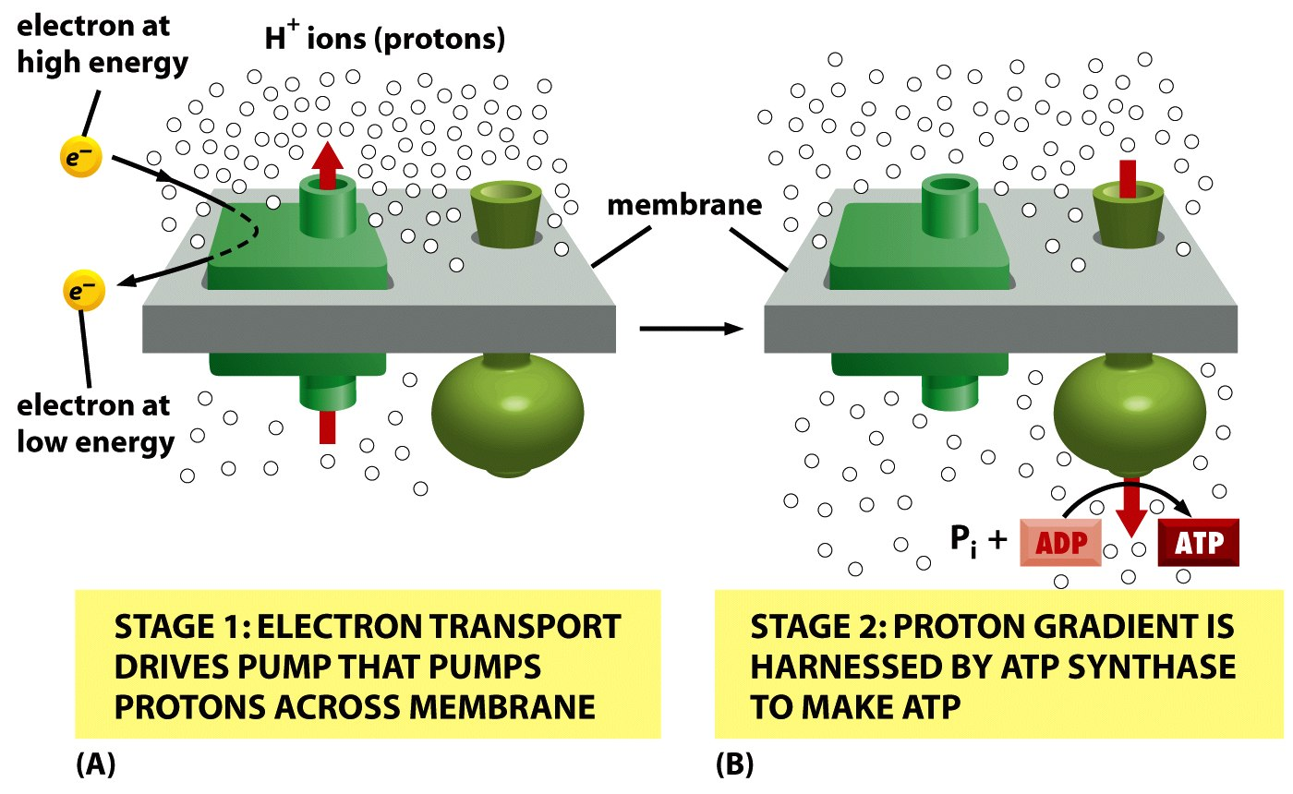
NADH
O2
AAAAAATP
Figure 14-1 Molecular Biology of the Cell (© Garland Science 2008)

Slide 5
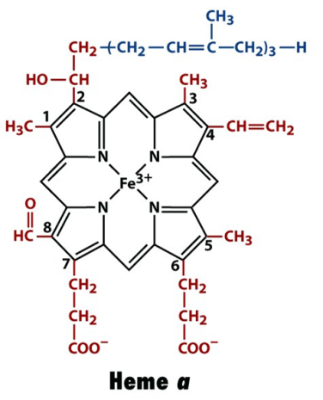
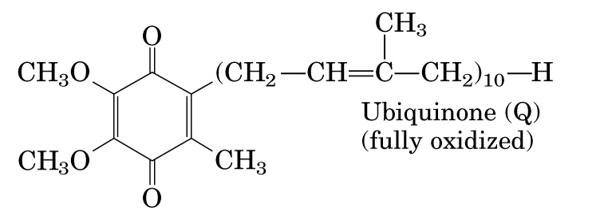
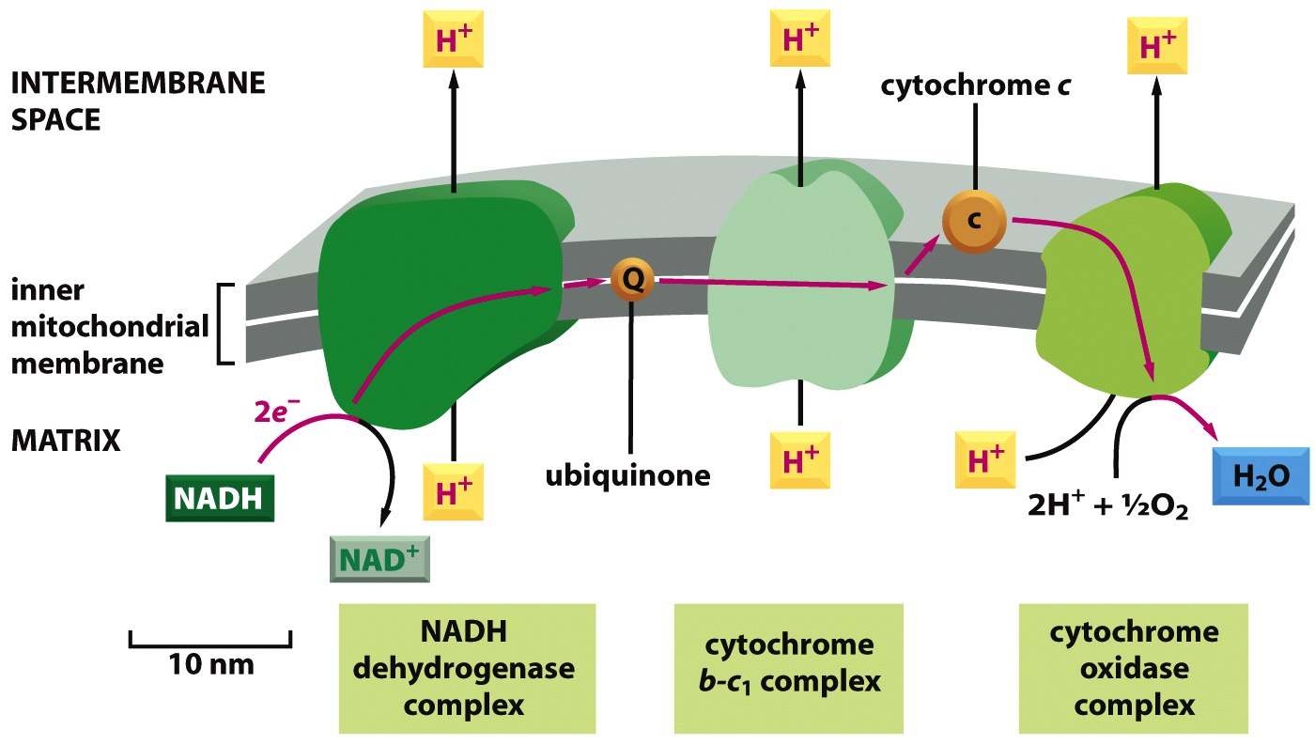
Figure 14-26 Molecular Biology of the Cell (© Garland Science 2008)

Slide 6
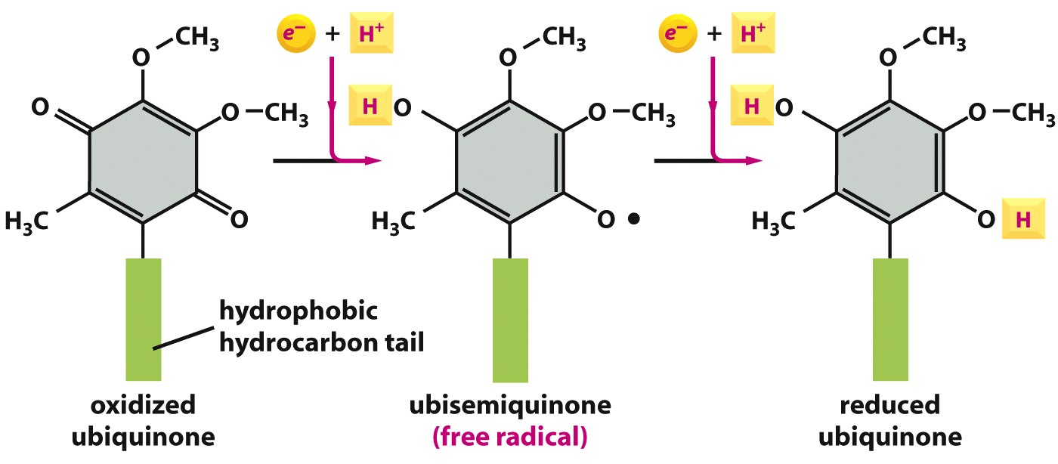
Figure 14-24 Molecular Biology of the Cell (© Garland Science 2008)

Slide 7
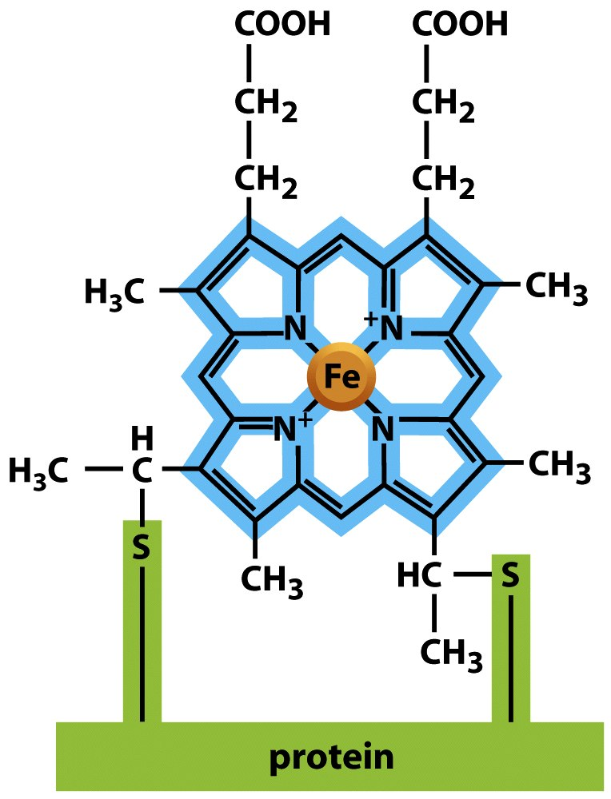
Figure 14-22 Molecular Biology of the Cell (© Garland Science 2008)

Slide 8
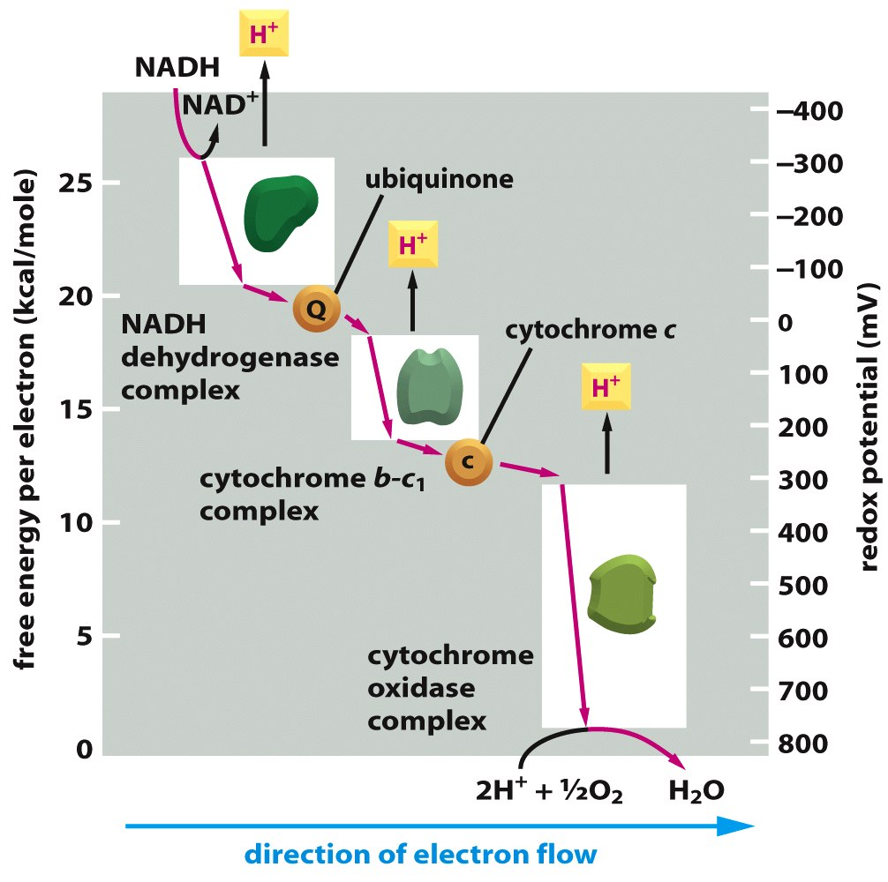
Figure 14-29 Molecular Biology of the Cell (© Garland Science 2008)

Slide 9
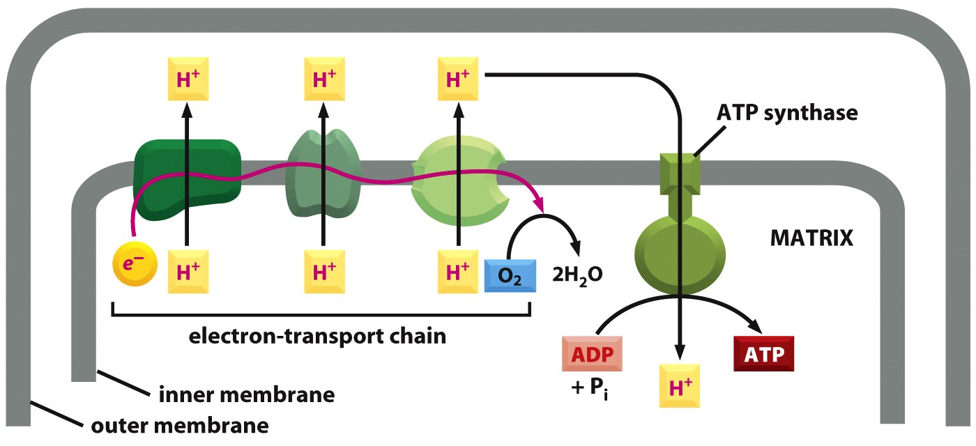
Figure 14-14 Molecular Biology of the Cell (© Garland Science 2008)

Slide 10
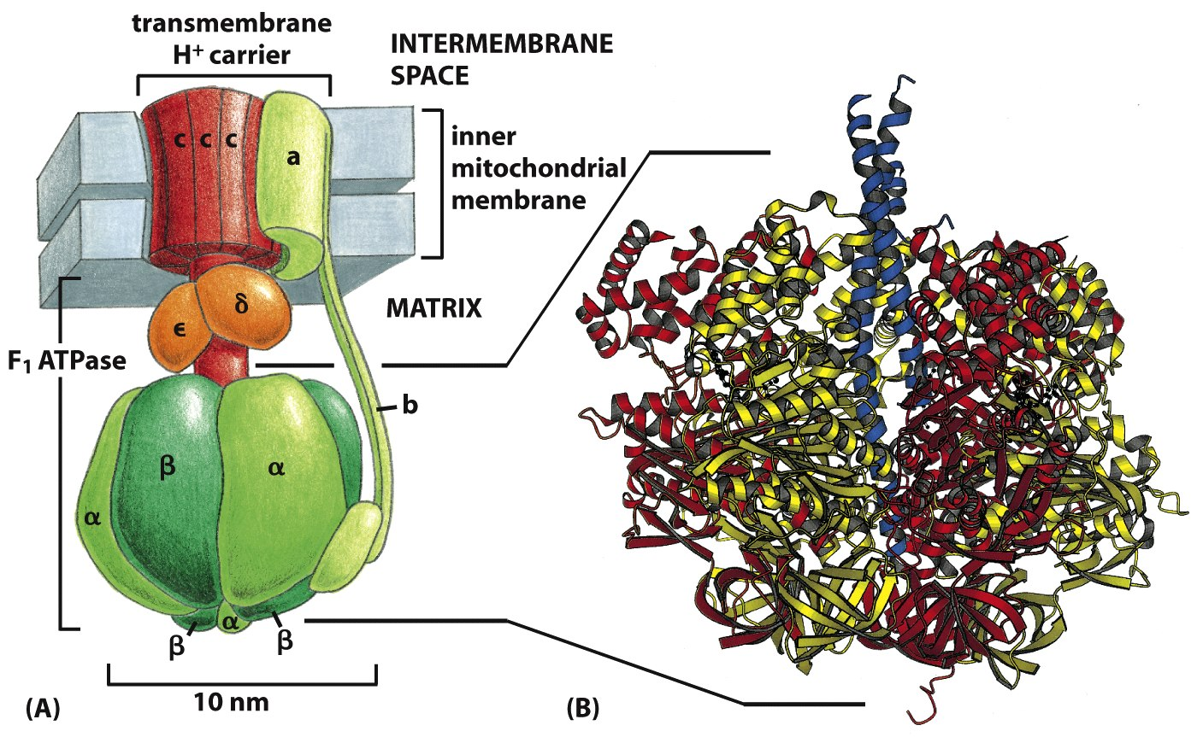
Figure 14-15 Molecular Biology of the Cell (© Garland Science 2008)

Slide 11
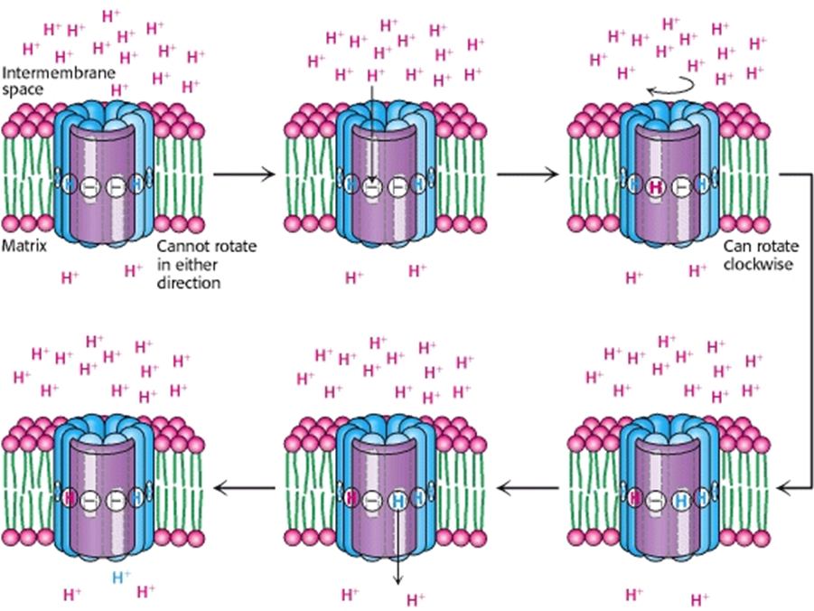

Slide 12
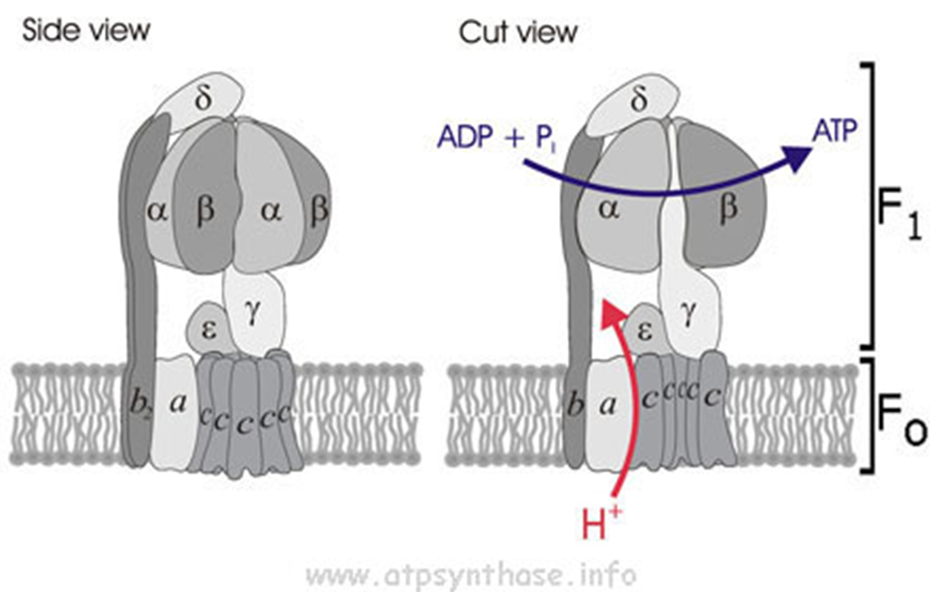

Slide 13
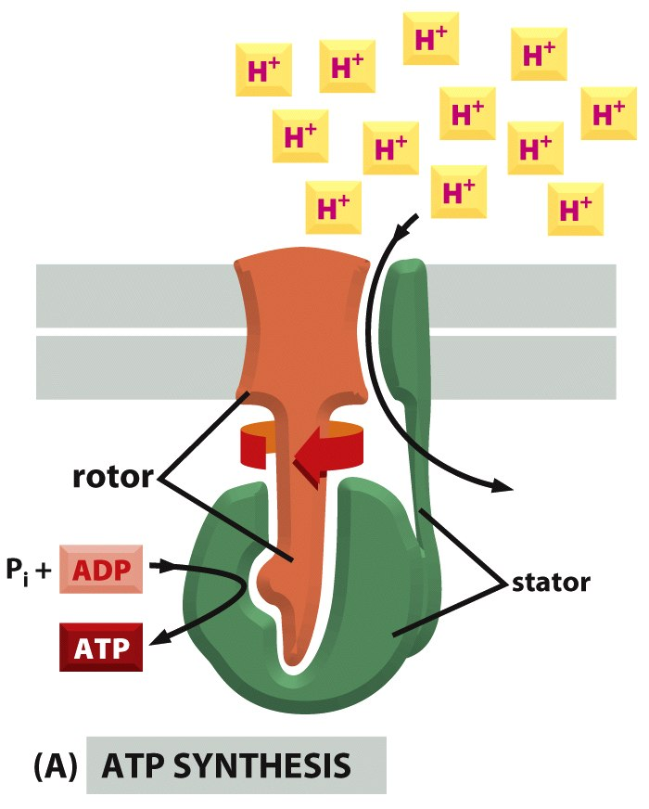
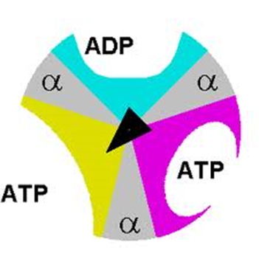
Figure 14-19 Molecular Biology of the Cell (© Garland Science 2008)

Slide 14
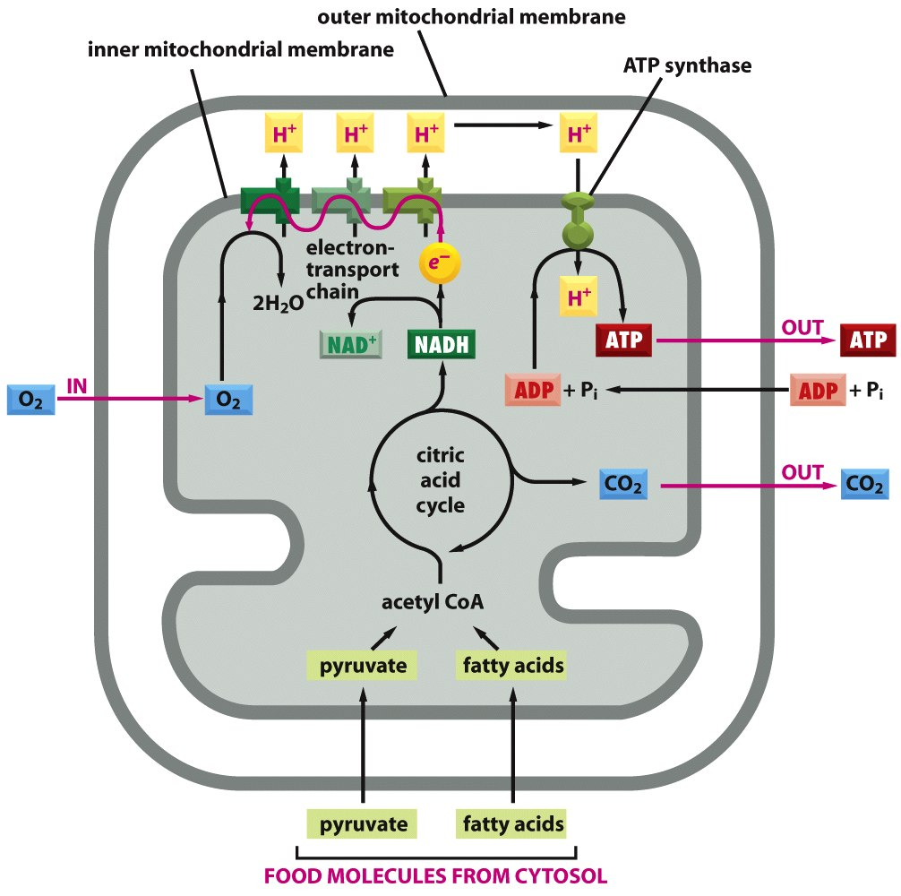

Slide 16
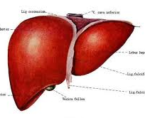
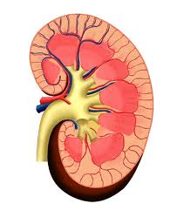
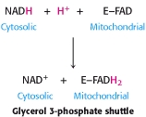
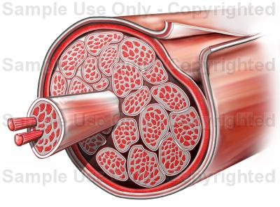
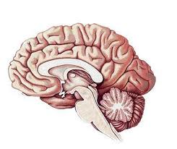
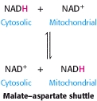
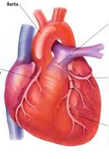
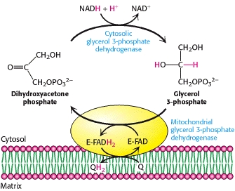
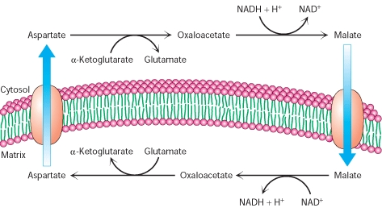
PONTOS DE ENTRADA NA MITOCÔNDRIA - NADH
Lançadeira Malato - Aspartato
Lançadeira Gliceraldeído 3P

Slide 17
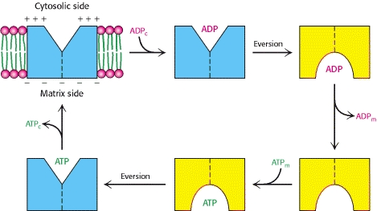
PONTOS DE ENTRADA NA MITOCÔNDRIA
ATP

